Slide 1
Importance of Feature Selection
Archa V R | :Reg. No. 35922007
Harikrishnan S | : Reg. No. 35922014
Jumana Sherin | : Reg. No. 35922018
Sneha Elizabeth S | : Reg. No. 35922024
Group Members

Slide 2
Feature Selection
Feature selection is the process of selecting a subset of relevant features or variables from a larger set of features that are available in a dataset. It is the process of identifying the most important and informative features that contribute to the predictive performance of a machine learning model.
The goal of feature selection is to improve the performance of a model by reducing the dimensionality of the dataset, while maintaining or improving the accuracy of the model.

Slide 3
Feature Selection
There are different approaches to feature selection:
1.Filter methods.
2.Wrapper methods.
3.Embedded methods.
Filter methods: This method involve selecting features based on statistical measures, such as correlation or mutual information, without taking into account the performance of the model.
Wrapper methods: On the other hand, use the model's performance as a criterion for feature selection by evaluating the model with different subsets of features.
Embedded methods: This method integrate feature selection into the model-building process, such as with regularization techniques like Lasso or Ridge regression.

Slide 4
Importance of Feature Selection
It can help to reduce overfitting.
Improve model interpretability.
Reduce computational costs.
Reduces training time.
It is also useful for identifying the most relevant features for a particular problem, which can lead to a better understanding of the underlying data and potentially lead to new insights.

Slide 5
Data Sets Used
Iris
Multivariate data set.
Contains a set of 150 records .
Attributes - Petal Length, Petal Width, Sepal Length, Sepal width; Class - Species.
Diabetes
Numeric data set
Contains 768 records
Attributes - Pregnancies, Glucose, Blood Pressure, Skin Thickness, Insulin, BMI, Diabetes Pedigree Function, Age.
Classes - 0 (tested negative), 1 (tested positive)
Wine
Categorical data
Describes the amount of various chemicals present in wine and their effect on it's quality.
Attributes - fixed acidity, volatile acidity, citric acid, residual sugar, chlorides, free sulfur dioxide, total sulfur dioxide, density, pH, sulphates, alcohol.
Classes - Quality (score between 0 and 10)

Slide 6
Topics
^{Feature Selection Algorithm}
^{1. Random Forest}
^{2. Decision Tree}
3. Recursive Feature Elimination
^{Classifier}
^{1. Support Vector Machine}
^{2. Decision Tree Classifier}
^{3. K-Nearest Neighbour}

Slide 7
Decision Tree
A decision tree is a machine learning algorithm that is commonly used for both classification and regression tasks. It is a supervised learning method that learns a hierarchical structure of decision rules based on the features of the input data.
The decision tree feature selection algorithm follows a recursive process to select the most important features for a given task. The basic idea is to construct a decision tree that maximally separates the data based on the features, and then use the tree structure to rank the importance of the features.
The algorithm starts with all features and constructs a decision tree using the entire dataset. It then evaluates the importance of each feature based on how much it contributes to the overall accuracy of the tree. The feature with the highest importance is selected and the tree is re-built using only that feature. This process is repeated until a predetermined number of features are selected, or until the desired level of accuracy is achieved.

Slide 8
Random Forest
Random forest is a machine learning algorithm that is commonly used for classification, regression, and feature selection tasks. It is an ensemble learning method that combines multiple decision trees to improve the accuracy and stability of the model.
In a random forest, each decision tree is built using a random subset of the training data and a random subset of the features. This helps to reduce the risk of overfitting, as each tree is built using a slightly different subset of the data and features. The final prediction of the random forest is then based on the combined predictions of all the individual decision trees.
After constructing the decision trees, the algorithm ranks the importance of each feature based on how much the accuracy of the random forest model is reduced when that feature is removed. The feature with the lowest importance score is then eliminated, and the process is repeated until a predetermined number of features is selected.

Slide 9
Recursive Feature Elimination
Recursive Feature Elimination is a feature selection method used in machine learning. It is a wrapper method that works by recursively removing features and building a model on the remaining features until a desired number of features is reached or the performance of the model stops improving.
In RFE, a machine learning algorithm is trained on the entire dataset with all the features. The feature weights are then calculated, and the least important feature(s) are removed from the dataset. The algorithm is retrained on the reduced dataset, and the feature weights are recalculated. This process is repeated until the desired number of features is reached.
In this method, a Ridge Regression model is first trained on the entire dataset, and the feature coefficients are used to rank the features based on their importance. The feature with the smallest coefficient is then eliminated, and a new Ridge Regression model is trained on the remaining features. The process of elimination and model training is repeated until the desired number of features is selected. The Ridge Regression model is used as the estimator because it shrinks the coefficients of less important features towards zero, making it well-suited for feature selection tasks.

Slide 10
Comparing Advantages
Decision Tree | Random Forest | Recursive Feature Elimination
Interpretability Handling both categorical and numerical data. Nonlinear relationships Scalability Flexibility Little data preparation | Robustness Handling missing values and outliers Versatility Scalability Accuracy Feature Importance Resilience to noisy data | Robustness Improved model performance Versatility Compatibility with various models Flexibility Feature ranking

Slide 11
Comparison of Disadvantages
Decision Tree | Random Forest | Recursive Feature Elimination
Overfitting Instability Bias Limited expressiveness Imbalanced classes Greedy nature Inconsistency with small changes | Overfitting Complexity Bias towards categorical variables Computationally expensive Memory usage Lack of transparency Poor performance on rare events | Computational complexity Hyperparameter tuning Performance metric dependency Model dependence Feature interactions Large feature sets Subjectivity

Slide 12
Classifier
In machine learning, classifiers are algorithms that are used to assign a label or class to a given input data point based on its features. They are used in supervised learning, where the training data has known labels or classes, and the goal is to learn a mapping from the input features to the output labels.
Classifiers can be used for a variety of tasks such as image classification, text classification, spam filtering, fraud detection, and medical diagnosis. They can be broadly categorized into two types:
Binary classifiers: These classifiers assign a binary label, typically 0 or 1, to each input data point. For example, a binary classifier could be used to classify email messages as spam or not spam.
Multi-class classifiers: These classifiers assign one of several possible labels or classes to each input data point. For example, a multi-class classifier could be used to classify images into different categories such as dogs, cats, or birds.

Slide 13
Support Vector Machine
SVM stands for Support Vector Machines, which is a supervised learning algorithm used for classification, regression, and outlier detection tasks in machine learning.
The main idea behind SVM is to find the hyperplane that best separates the data points into different classes. In a two-class classification problem, the hyperplane is the decision boundary that maximizes the margin, which is the distance between the hyperplane and the closest data points from each class. SVM can handle both linearly separable and non-linearly separable data by using different types of kernels to transform the data into a higher dimensional space.
The SVM algorithm works by finding the optimal solution of a constrained optimization problem, which involves minimizing the classification error and maximizing the margin. The optimization problem can be solved using different techniques such as quadratic programming, gradient descent, or interior point methods.

Slide 14
Decision Tree Classifier
A decision tree classifier is a type of supervised machine learning algorithm that is commonly used for classification tasks. The algorithm works by recursively partitioning the data into subsets based on the values of different features, in order to create a tree-like model that can be used for classification.
At each node of the decision tree, the algorithm selects the feature that provides the most information gain, which is typically calculated using measures such as entropy or Gini impurity. The feature with the highest information gain is used to split the data into two or more subsets, which are then processed recursively until a stopping criterion is met (e.g. a maximum depth of the tree is reached or a minimum number of instances in a leaf node is reached).
Once the decision tree has been constructed, it can be used to predict the class of new instances by traversing the tree from the root node to a leaf node, using the values of the features to determine which path to take at each node. The class assigned to the leaf node reached by the traversal is the predicted class of the new instance.

Slide 15
KNN
KNN (K-Nearest Neighbors) is a simple, non-parametric algorithm used for classification and regression tasks. The basic idea behind the KNN algorithm is to find the K nearest data points to a new data point in the feature space, and then use the majority class (in the case of classification) of those K neighbors to predict the class or value of the new data point.
In the KNN algorithm, the distance between two data points is typically measured using Euclidean distance or some other distance metric. The value of K is a hyperparameter that must be chosen before training the algorithm, and it determines how many neighbors to consider when making a prediction.

Slide 16
Comparison of Advantages
Support Vector Machine | Decision Tree | K-Nearest Neighbors
Effective in high-dimensional spaces. Good generalization performance. Robust to noise. Versatility. Effective with small datasets. Control overfitting | Easy to interpret Fast to train Handle both categorical and numerical data Robust to noise Non-parametric Feature selection Can be used for both classification and regression | Simple to understand and implement No training required Robust to noisy data Versatile Non-parametric Adaptability High accuracy

Slide 17
Comparison of Disadvantages
Support Vector Machine | Decision Tree | K-Nearest Neighbors
Sensitivity to parameter settings. Computationally intensive. Limited interpretability. Data scaling. Binary classification. Imbalanced datasets. Memory-intensive. | Overfitting Instability Bias Limited expressiveness Imbalanced classes Greedy nature Inconsistency with small changes | Sensitivity to feature scaling Computationally intensive Choice of K Not suitable for high-dimensional data Imbalanced datasets Requires labeled data

Slide 18
Confusion Matrix
Table that is used to evaluate the performance of a classification model by comparing its predicted output with the actual output.
Helps us to understand how well the model is performing by providing us with information on the number of correct and incorrect predictions.
The confusion matrix is typically represented as a table with four cells, with each cell representing one of the four possible outcomes of a binary classification problem:
True Positive (TP): the model correctly predicted a positive (e.g. a person has a disease)
False Positive (FP): the model incorrectly predicted a positive (e.g. a person does not have a disease but the model predicted that they do)
True Negative (TN): the model correctly predicted a negative (e.g. a person does not have a disease)
False Negative (FN): the model incorrectly predicted a negative (e.g. a person has a disease but the model predicted that they do not)
Accuracy = (TP + TN) / (TP + TN + FP + FN)

Slide 19
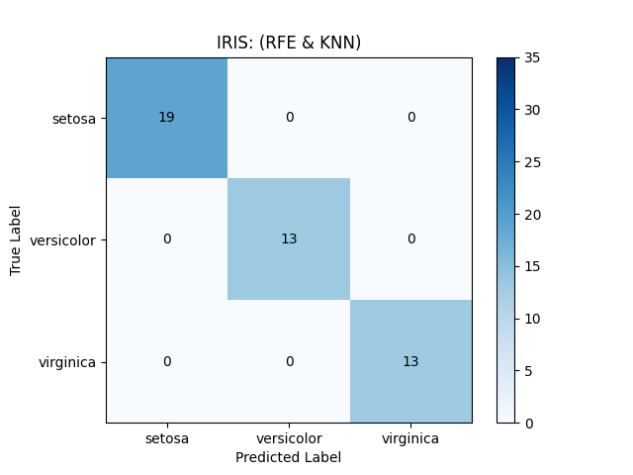
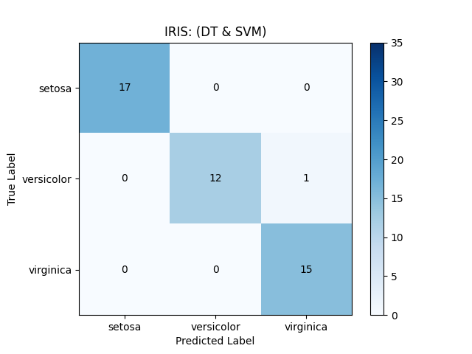
Confusion Matrix : Iris
Best Case
Worst Case

Slide 20
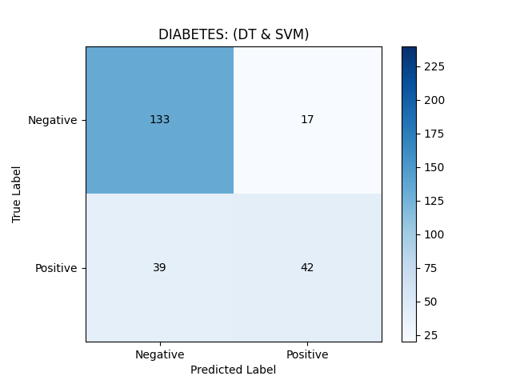
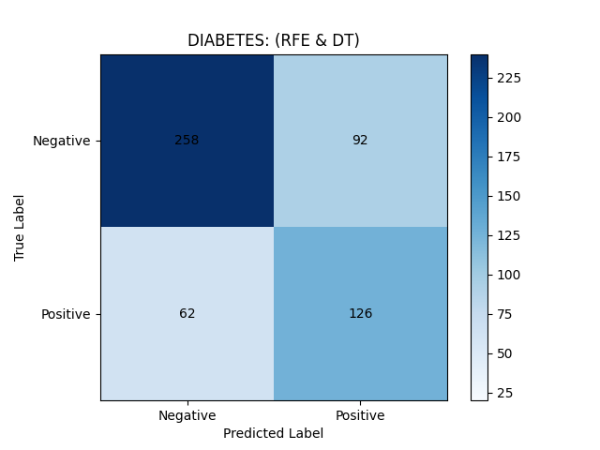
Confusion Matrix : Diabetes
Best Case
Worst Case

Slide 21
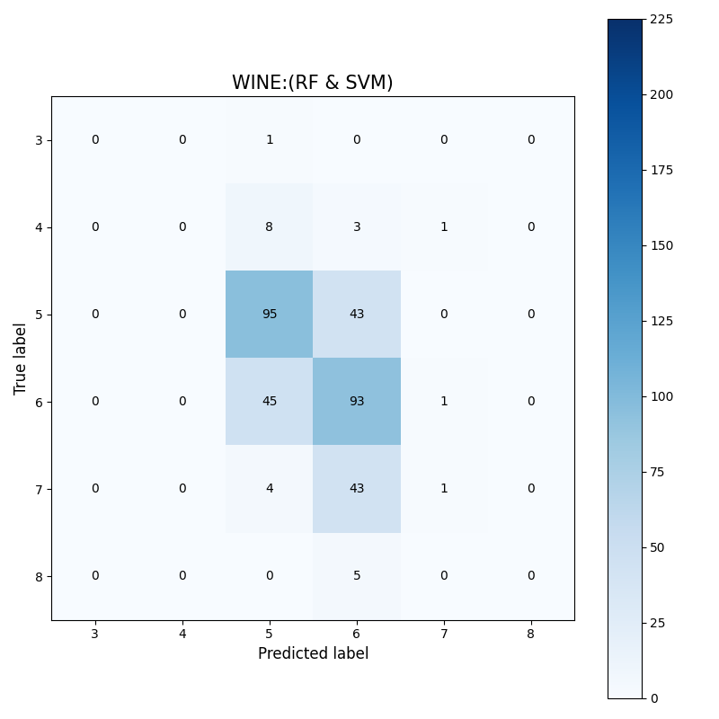
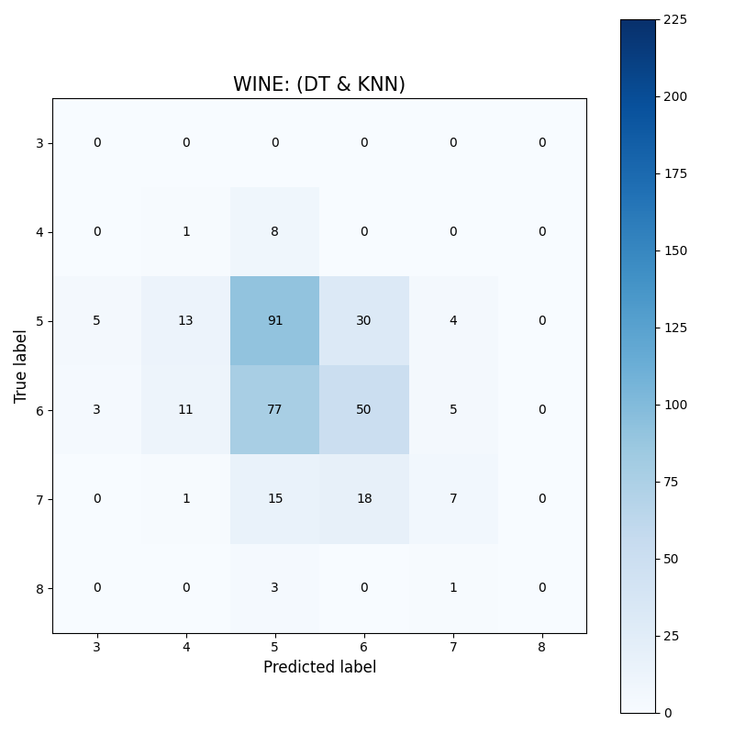
Confusion Matrix : Wine
Best Case
Worst Case

Slide 22
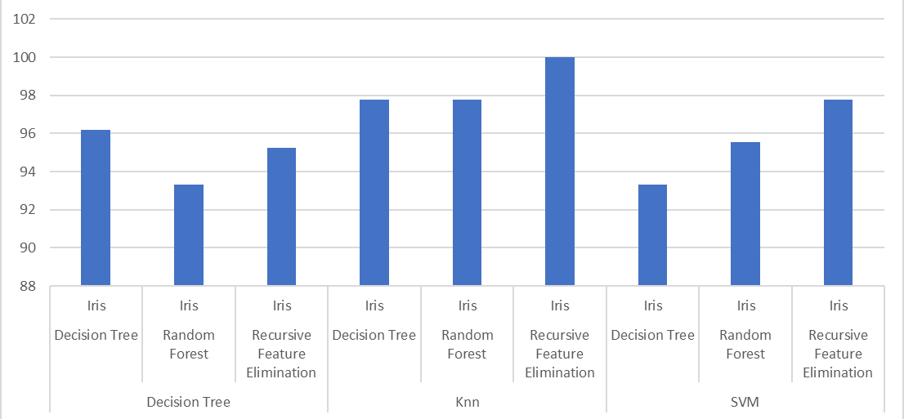
Accuracy Chart of Iris Data

Slide 23
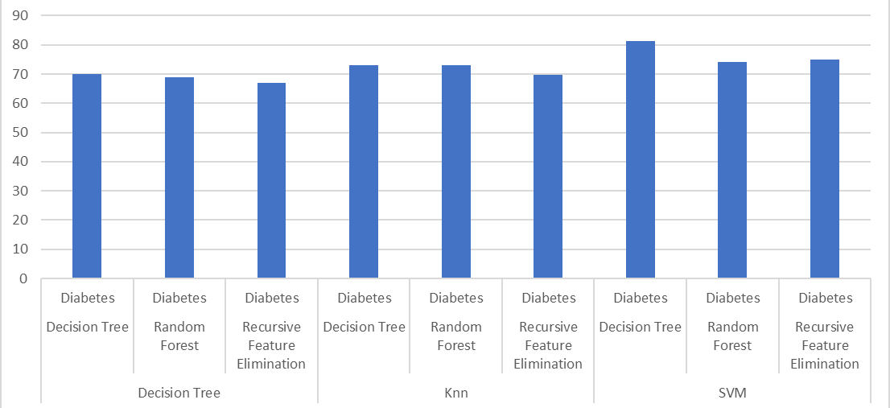
Accuracy Chart of Diabetes Data

Slide 24
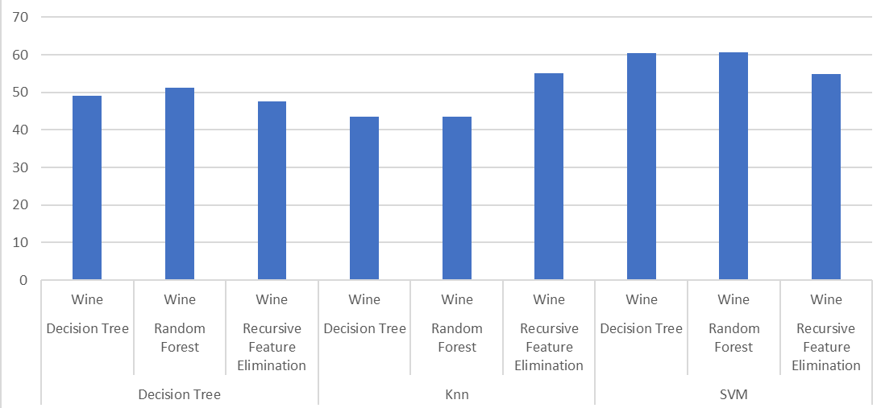
Accuracy Chart of Wine Data

Slide 25
Conclusion
In the case of Iris data, the combination of feature selection algorithm and classifier that gives the best accuracy is Recursive Feature Elimination and KNN. Hence, for similar multivariate datasets this combination can be applied to obtain the best classification result.
For Diabetes data, the best combination is Decision Tree and Support Vector Machine. This combination can be applied to similar numeric datasets for best results.
For Wine data, Random Forest with Support Vector Machine gives the most accurate result. Therefore, this combination is suitable for similar kind of categorical data.

